Slide 1

Data Analytics in Social Media
Vivek Raja P S Data Scientist @ NexStem

Slide 2
Overview of today’s session
Understand how social media is the highest data churning source and learn the ways to extract, analyze and derive insights from it Learning Process:
- Social Media & Analytics
- Data from Social Media
- Performing analytics from Social Media Data

Slide 3
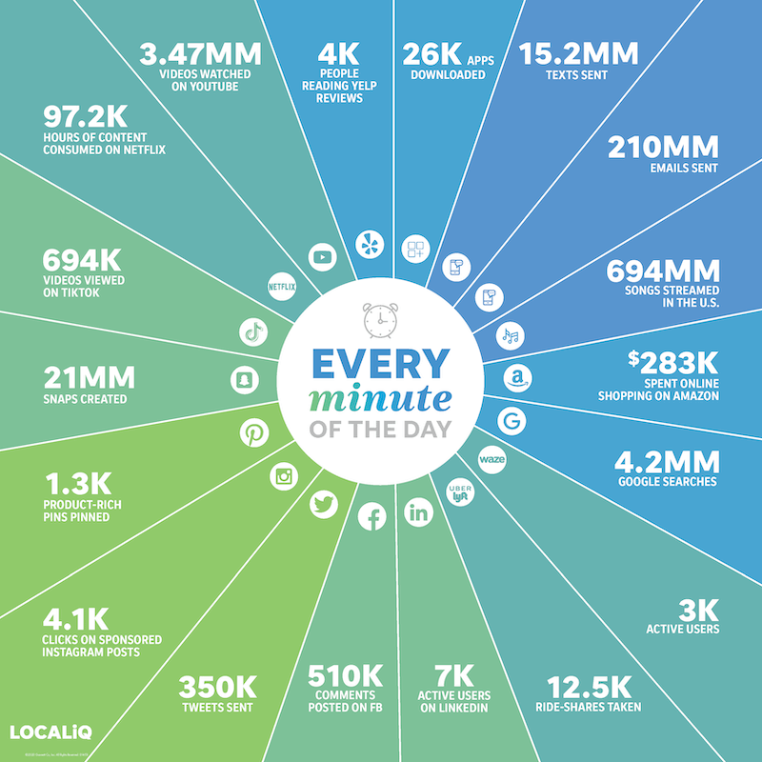

Slide 4
Social Media’s Impact Across The Purchase Journey
% of Internet users who…
Discover brands via ads on social media
28%
Discover brands via recommendations/comments on social media
25%
Use social networks to research products
42%
Clicked on a sponsored post on Instagram (among Instagram visitors)
17%
Motivated to purchase by lots of likes/good comments on social media
22%
Motivated to purchase by a “buy” button
12%

Slide 5
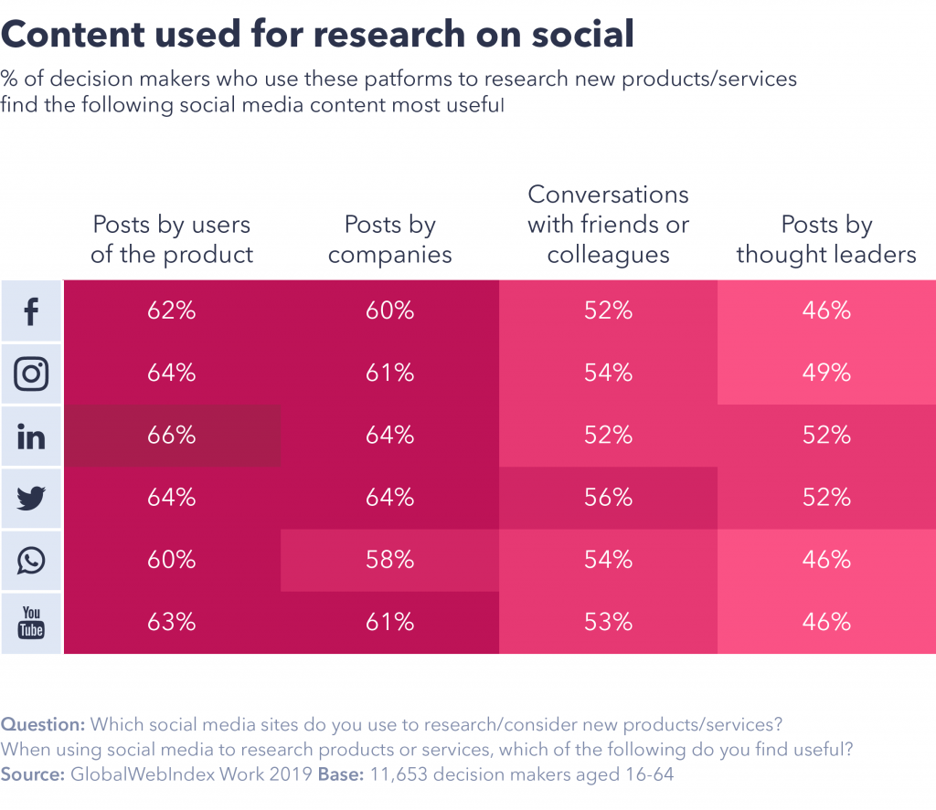
Content used for research on social
% of decision makers who use these platforms to research new products/services find the following social media content most useful
71% of all decision makers say social media is influential when they’re researching or considering a new product for their company.
Those aged 55-64, however, say blogs and online ads are on par with social media as a source of product information.
Social Media platforms are also gradually becoming a place to complete purchases, as networks mature further
Social Media is the golden thread of the whole customer journey throughout, as it allows a unified customer experience, as people are buying into experiences, not just products. Social compresses the customer journey from days to hours.
Posts by users of the product | Posts by companies | Conversations with friends or colleagues | Posts by Influencers/ Thought Leaders
62% | 60% | 52% | 46%
64% | 61% | 54% | 49%
66% | 64% | 52% | 52%
64% | 64% | 56% | 52%
60% | 58% | 54% | 46%
63% | 61% | 53% | 46%

Slide 6
Overview of Social Media Analytics

Slide 7
Social media analytics is the ability to gather and find meaning in data
Measure the performance of actions based on those decisions through social media.

Slide 8
Social media analytics uses specifically designed software platforms that work similarly to web search tools. Data about keywords or topics is retrieved through search queries or web ‘crawlers’ that span channels. Fragments of text are returned, loaded into a database, categorized and analyzed to derive meaningful insights. Social media analytics includes the concept of social listening. Listening is monitoring social channels for problems and opportunities. Social media analytics tools typically incorporate listening into more comprehensive reporting that involves listening and performance analysis.

Slide 9
Why Social Media analytics?

Slide 10
Social media analytics helps companies address these experiences and use them to:
Spot trends related to offerings and brands
Understand conversations — what is being said and how it is being received
Derive customer sentiment towards products and services
Gauge response to social media and other communications
Identify high-value features for a product or service
Uncover what competitors are saying and its effectiveness
Map how third-party partners and channels may affect performance

Slide 11
These strategies affect a range of business activity: These strategies affect a range of business activity: These strategies affect a range of business activity: These strategies affect a range of business activity: Business Activities
Product development - Analyzing an aggregate of Facebook posts, tweets and Amazon product reviews can deliver a clearer picture of customer pain points, shifting needs and desired features. Trends can be identified and tracked to shape the management of existing product lines as well as guide new product development.
Customer experience - An IBM study discovered “organizations are evolving from product-led to experience-led businesses.” Behavioral analysis can be applied across social channels to capitalize on micro-moments to delight customers and increase loyalty and lifetime value. Branding - Social media may be the world’s largest focus group. Natural language processing and sentiment analysis can continually monitor positive or negative expectations to maintain brand health, refine positioning and develop new brand attributes.
Competitive Analysis - Understanding what competitors are doing and how customers are responding is always critical. For example, a competitor may indicate that they are foregoing a niche market, creating an opportunity. Or a spike in positive mentions for a new product can alert organizations to market disruptors.
Operational efficiency – Deep analysis of social media can help organizations improve how they gauge demand. Retailers and others can use that information to manage inventory and suppliers, reduce costs and optimize resources.

Slide 12
Key capabilities of effective social media analytics

Slide 13
Social Media Analytics Process
Capture
Gather data
Extract pertinent information from the data
Understand
Remove noisy data
Perform advanced analytics
Present
Summarize and evaluate the finding
Present the findings
Preprocess the data

Slide 14
Capture
Identify conversations on social media platforms related to its activities and interests.
The capture phase covers popular platforms such as Facebook, Twitter, LinkedIn, YouTube, Pinterest,Tumblr
Some ways to capture data: using Cloud-based archiving services like Archive social, PageFreezer, Backuppify

Slide 15
Understand
Clean data by using some statistical methods and other techniques from text, data mining, machine translation, network analysis
Provides information about users’ sentiments—how they feel about the company and its products—and their behaviors

Slide 16
Present
Summarize and evaluate the finding
Present the findings

Slide 17
Natural language processing and machine learning technologies identify entities and relationships in unstructured data — information not pre-formatted to work with data analytics. Virtually all social media content is unstructured. These technologies are critical to deriving meaningful insights.
Segmentation is a fundamental need in social media analytics. It categorizes social media participants by geography, age, gender, marital status, parental status and other demographics. It can help identify influencers in those categories. Messages, initiatives and responses can be better tuned and targeted by understanding who is interacting on key topics.
Behavior analysis is used to understand the concerns of social media participants by assigning behavioral types such as user, recommender, prospective user and detractor. Understanding these roles helps develop targeted messages and responses to meet, change or deflect their perceptions.
Sentiment analysis measures the tone and intent of social media comments. It typically involves natural language processing technologies to help understand entities and relationships to reveal positive, negative, neutral or ambivalent attributes.
Share of voice analyzes prevalence and intensity in conversations regarding brand, products, services, reputation and more. It helps determine key issues and important topics. It also helps classify discussions as positive, negative, neutral or ambivalent.
Clustering analysis can uncover hidden conversations and unexpected insights. It makes associations between keywords or phrases that appear together frequently and derives new topics, issues and opportunities. The people that make baking soda, for example, discovered new uses and opportunities using clustering analysis.
Dashboards and visualization charts, graphs, tables and other presentation tools summarize and share social media analytics findings — a critical capability for communicating and acting on what has been learned. They also enable users to grasp meaning and insights more quickly and look deeper into specific findings without advanced technical skills.

Slide 18

How AI is used in Social Medias?

Slide 19
How is AI used in social media?
The world's most popular social media platforms have AI at their core.
By quickly understanding how top platforms use AI, you can quickly see why AI is so important in social media.

Slide 20
How does Facebook use AI?
Facebook uses AI to do everything from translate foreign languages to automatically classify images. In fact, AI is at the very center of how Facebook works.
The company's AI algorithms predict what content you will engage with most, based on your historical engagement. The platform then serves that content to you.
Facebook also uses AI to suggest ad copy and target advertising to audiences most likely to click and act on your ads.
Today, the company relies on AI for content moderation, using it to filter out offensive or harmful images, video, and text at scale.

Slide 21
How does Instagram use AI?
Like Facebook, Instagram uses AI to target ads and serve you interesting content based on what you've engaged with in the past.
It also leans on AI to filter out spam, since the platform has problems with spam bots posting comments and content.

Slide 22
How does YouTube use AI?
A big way YouTube now uses AI is to fight misinformation by identifying and flagging videos trying to spread the conspiracy theories and fake news that have proliferated in recent years.
YouTube also relies on AI to serve you content that it thinks you'll like to watch next.

Slide 23
How does TikTok use AI?
TikTok is one of the first social media platforms to be almost entirely governed by AI. Every video you see on TikTok is directly determined by AI ranking algorithms, optimized to deliver content that keeps you on the app.
Not to mention, TikTok has very, very smart AI: it learns from you quickly as you use it, serving up content completely customized to your interests.
TikTok also relies exclusively on AI to initially analyze videos uploaded to the platform (though humans may enter the review process later).

Slide 24
How do social media marketers use AI?
Decrease costs. AI can partially or fully automate some of the more labor-intensive tasks that take up your team's time, freeing them up to focus on higher-value tasks. That includes activities like scheduling and uploading shares, pulling relevant links and hashtags, and making research into what to post easier and faster.
Increase revenue. AI can also dramatically enhance the efficacy of your social media content and strategy, which translates into better engagement and results from your social media investments. AI can help you better determine which posts will be most effective, which audiences are most relevant, and which channels work best. It can even write ads that are more effective for you.

Slide 25

Why to add intelligence to social apps?

Slide 26
Business Intended Specific use cases –
Productivity based simple but powerful use cases
Use insights from historical data to make decisions –

Slide 27
NLP & Social Media
The challenges and the frustration :/

Slide 28
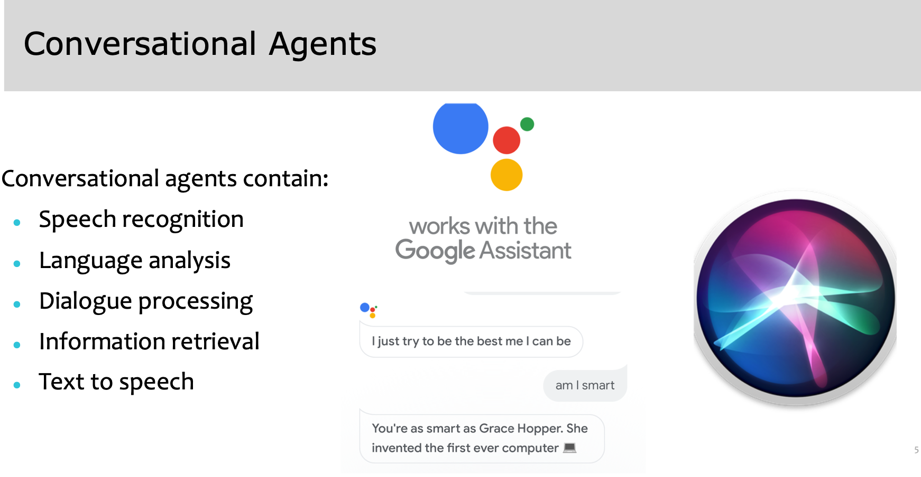

Slide 29
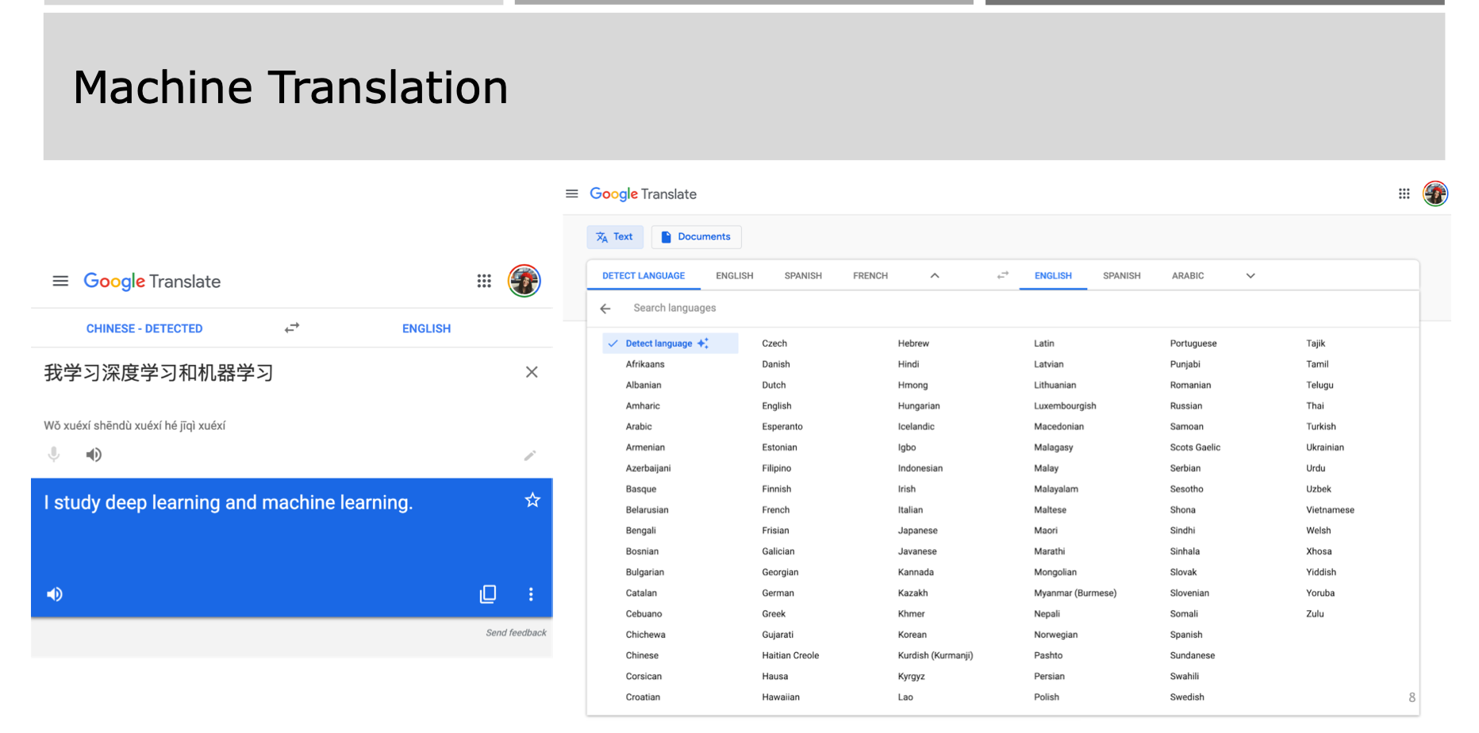

Slide 30
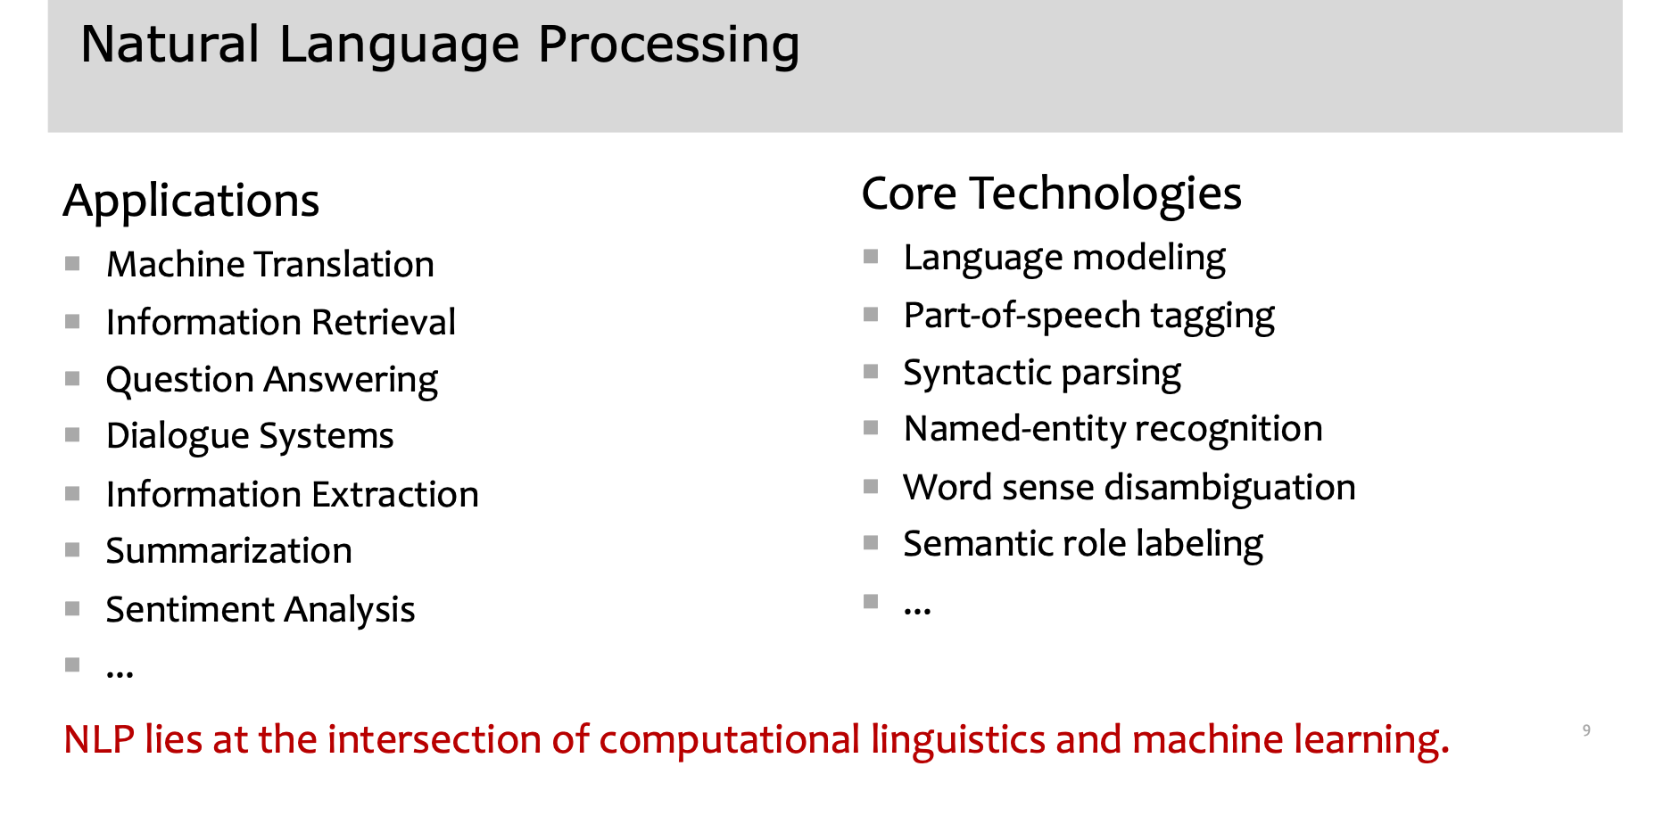

Slide 31
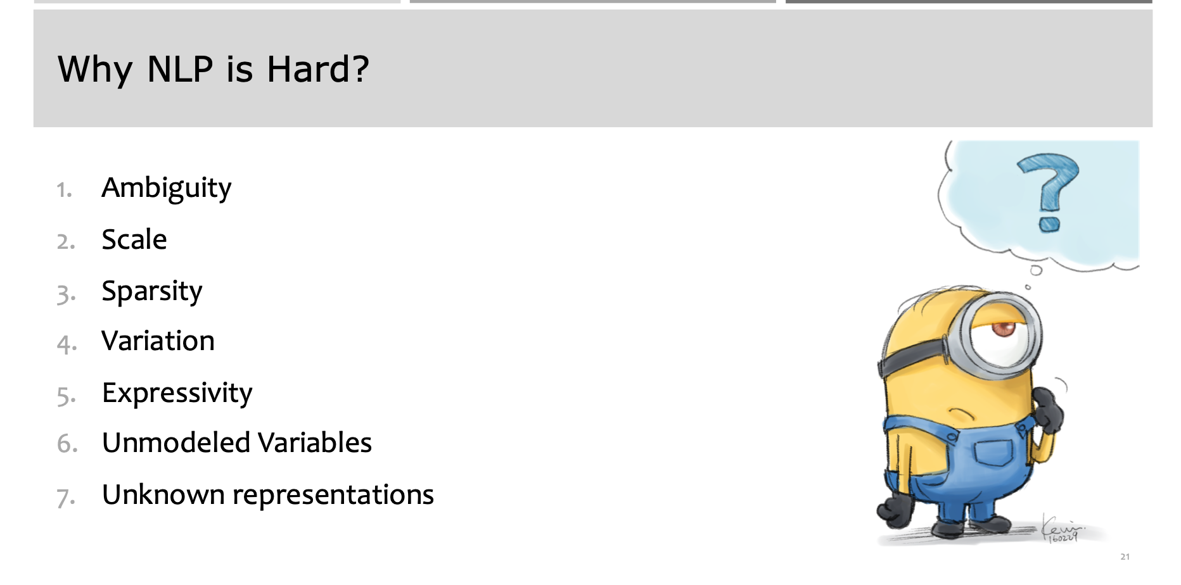

Slide 32
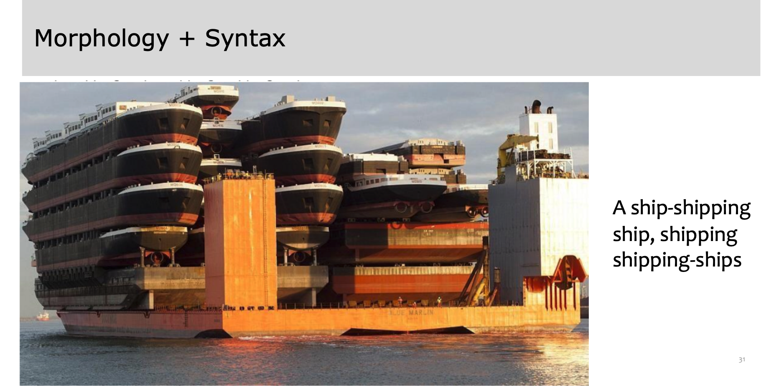

Slide 33

Social Media Segmentation
The art of knowing your audience

Slide 34
Different social media platforms cater to different groups of people. Even within a single social media platform, like Facebook, different users use it in different ways.
You need to know who’s using what, or you’ll end up dedicating time and resources to a channel your audience isn’t using . The best way to avoid doing that is with social media segmentation.
In fact, social media segmentation can help boost your entire marketing strategy by not only saving you time and money but also by making you more effective in the channels you do use.

Slide 35
Data

Slide 36
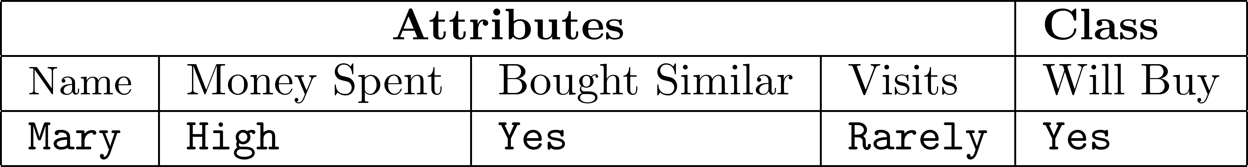
Data Instances
In the KDD process,
Data is in a tabular format (a set of instances)
Each instance is a collection of properties and features related to an object or person
A patient’s medical record
A user’s profile
A gene’s information
Instances are also called points, data points, or observations
Feature Value
Class Attribute
Data Instance:
Features ( Attributes or measurements)
Class Label

Slide 37
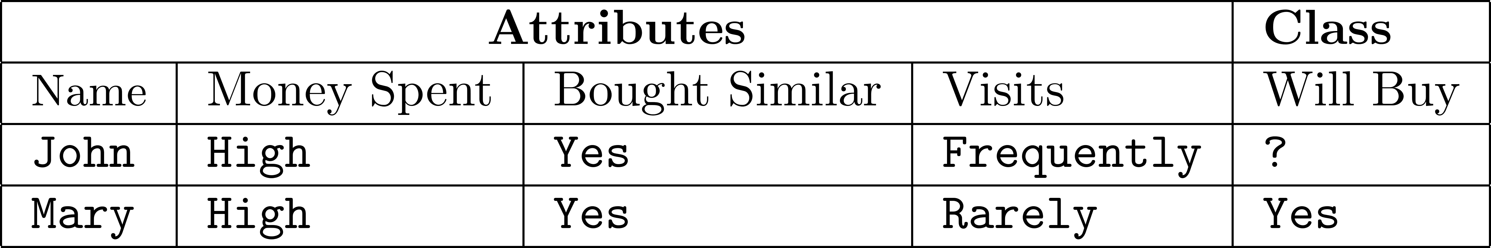
Data Instances
Predicting whether an individual who visits an online book seller is going to buy a specific book
Features can be
Continues: values are numeric values
Money spent: $25
Discrete: can take a number of values
Money spent: {high, normal, low}
Unlabeled
Example
Labeled
Example

Slide 38
Data Types + Permissible Operations (statistics)
Nominal
Operations:
Mode (most common feature value), Equality Comparison
E.g., {male, female}
Ordinal
Feature values have an intrinsic order to them, but the difference is not defined
Operations:
same as nominal, feature value rank
E.g., {Low, medium, high}
Interval
Operations:
Addition and subtractions are allowed whereas divisions and multiplications are not
E.g., 3:08 PM, calendar dates
Ratio
Operations:
divisions and multiplications are allowed
E.g., Height, weight, money quantities

Slide 39
Sample Dataset – Twitter Users
Activity | Date Joined | Number of Followers | Verified Account? | Has Profile Picture?
High | 2015 | 50 | FALSE | no
High | 2013 | 300 | TRUE | no
Average | 2011 | 860000 | FALSE | yes
Low | 2012 | 96 | FALSE | yes
High | 2008 | 8,000 | FALSE | yes
Average | 2009 | 5 | TRUE | no
Very High | 2010 | 650,000 | TRUE | yes
Low | 2010 | 95 | FALSE | no
Average | 2011 | 70 | FALSE | yes
Very High | 2013 | 80,000 | FALSE | yes
Low | 2014 | 70 | TRUE | yes
Average | 2013 | 900 | TRUE | yes
High | 2011 | 7500 | FALSE | yes
Low | 2010 | 910 | TRUE | no
Ordinal
Interval
Ratio
Nominal
Nominal
Notes:
Weather dataset

Slide 40
Text Representation
The most common way to represent documents is to transform them into vectors
Process them with linear algebraic operations
This representation is called “Bag of Words”
Vector Space Model
Weights for words can be assigned by TF-IDF

Slide 41
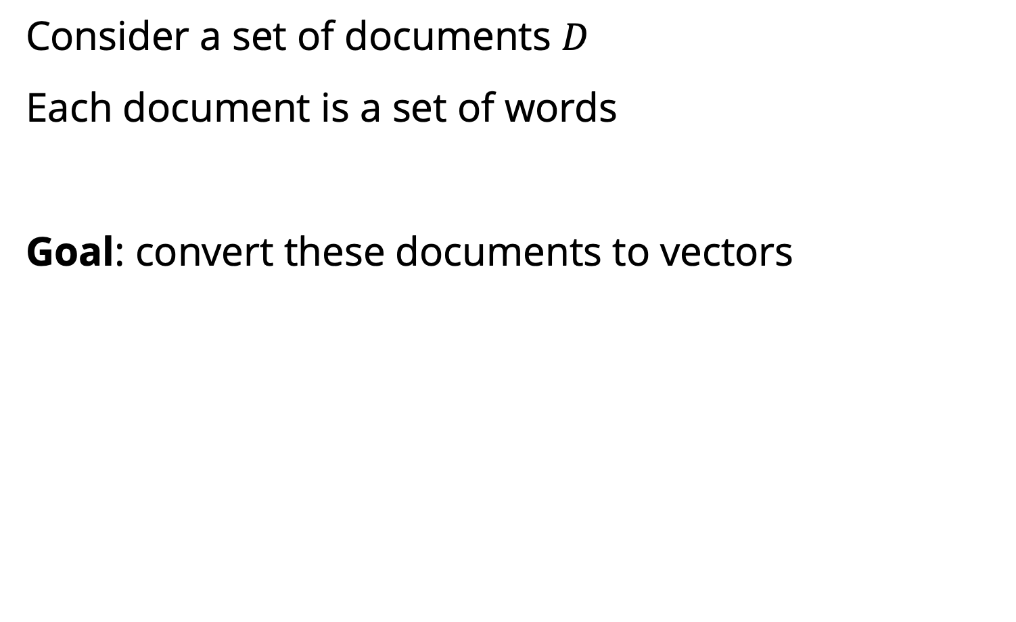
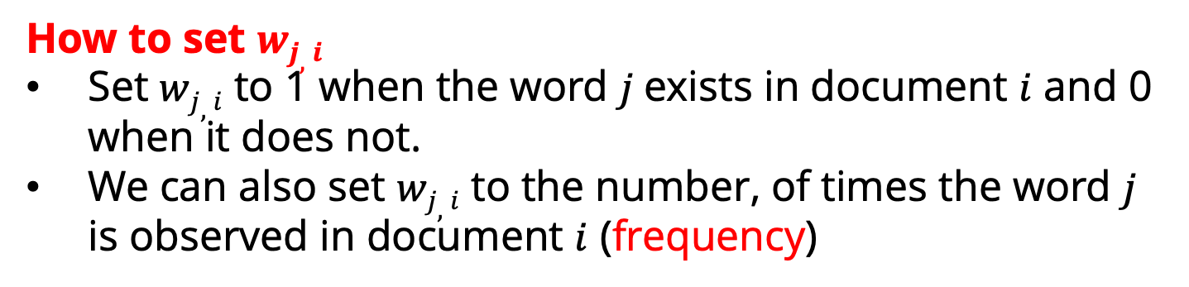
Vector Space Model
Consider a set of documents $D$
Each document is a set of words
Goal: convert these documents to vectors
$di$ : document $i$
$wj,i$ : the weight for word $j$ in document $i$
How to set $wj,i$
Set $wj,i$ to 1 when the word $j$exists in document $i$ and 0 when it does not.
We can also set $wj,i$ to the number, of times the word $j$ is observed in document $i$ (frequency)

Slide 42
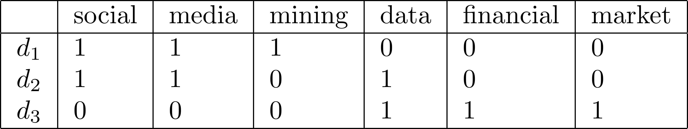
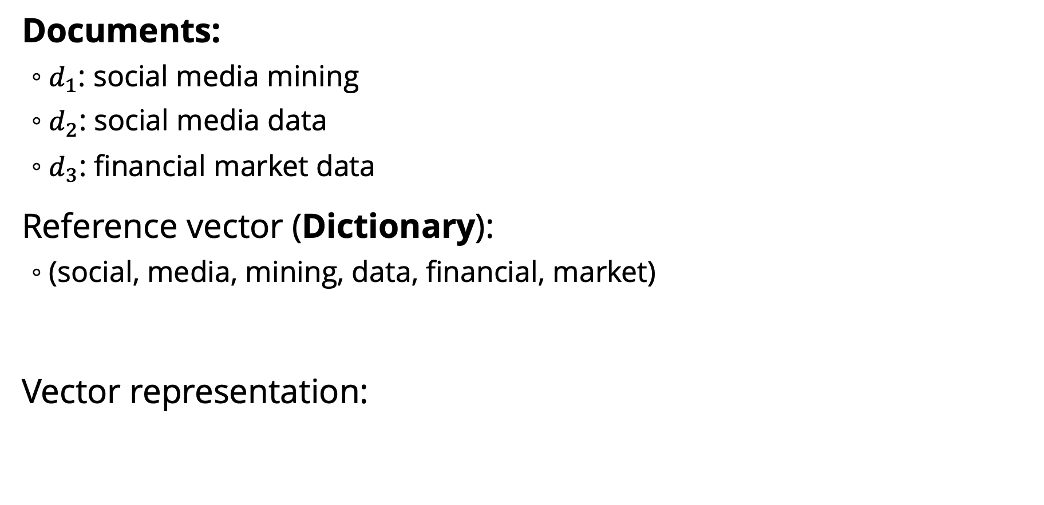
Vector Space Model: An Example
Documents:
$d_{1}$: social media mining
$d_{2}$: social media data
$d_{3}$: financial market data
Reference vector (Dictionary):
(social, media, mining, data, financial, market)
Vector representation:

Slide 43
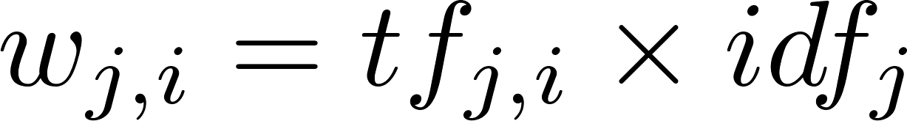
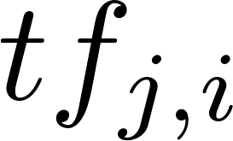
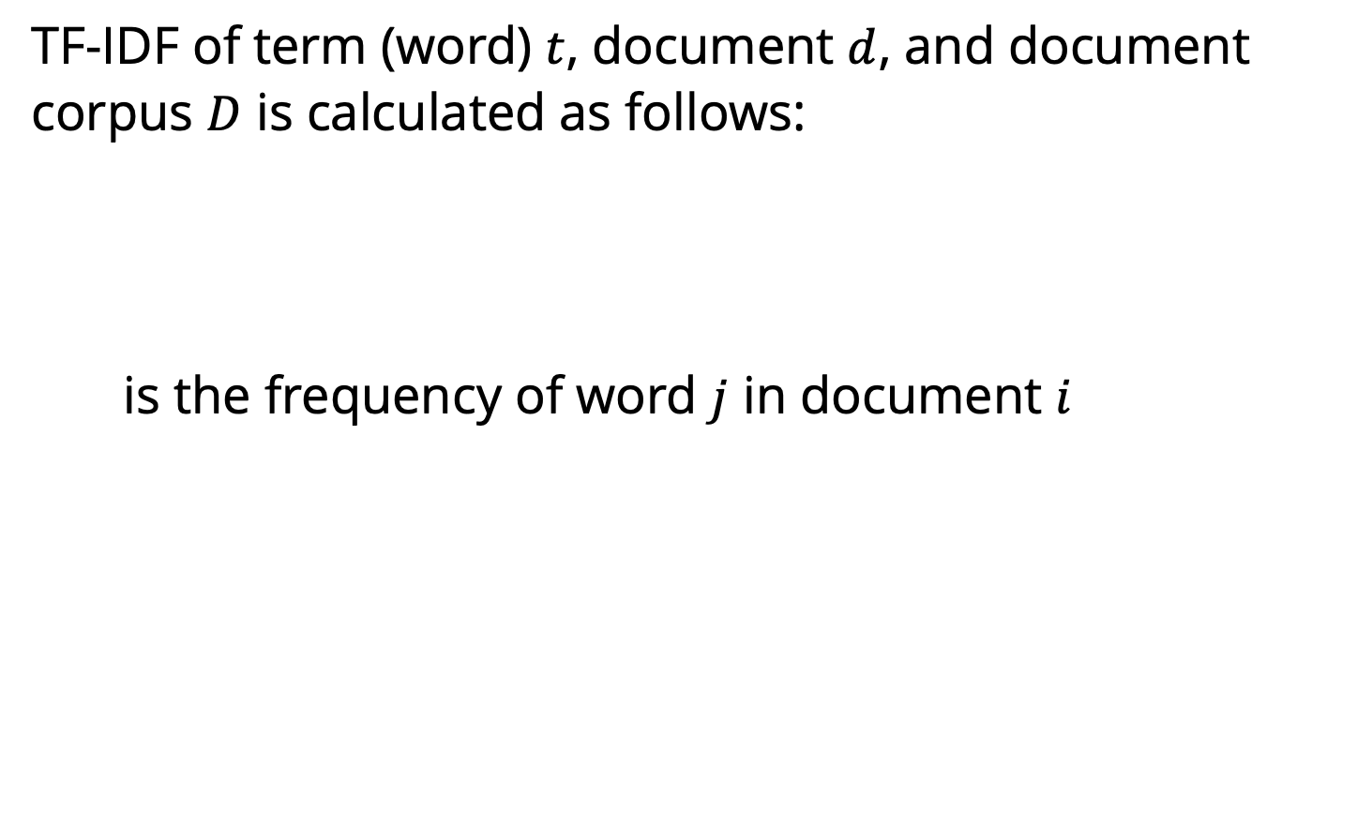
TF-IDF (Term Frequency-Inverse Document Frequency)
TF-IDF of term (word) $t$, document $d$, and document corpus $D$ is calculated as follows:
is the frequency of word $j$ in document $i$
The total number of documents in the corpus
The number of documents where the term $j$appears
Notes:
number of documents where the term t appears

Slide 44
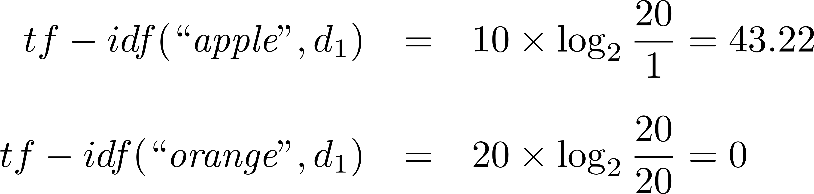
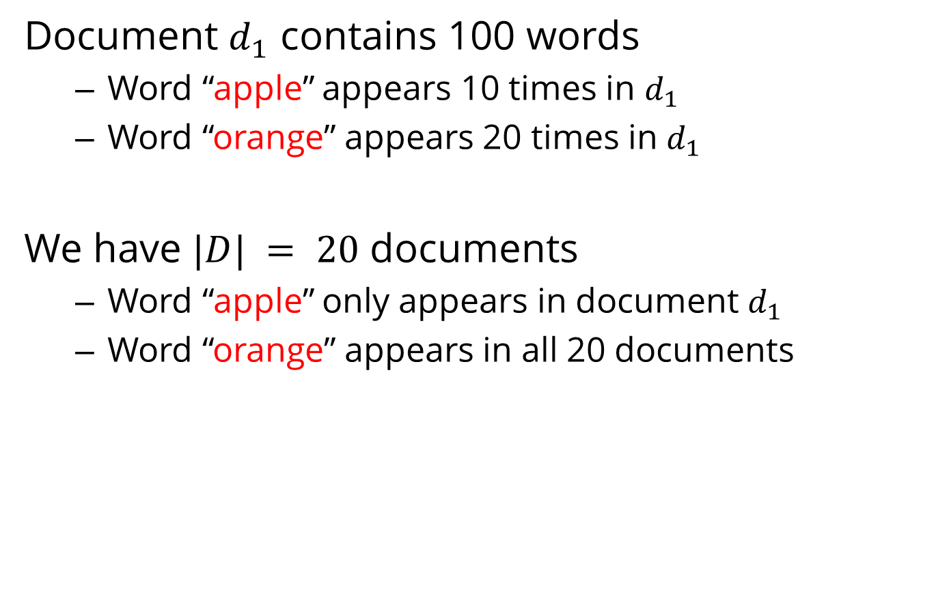
TF-IDF: An Example
Document $d_{1}$ contains 100 words
Word “apple” appears 10 times in $d_{1}$
Word “orange” appears 20 times in $d_{1}$
We have $|D| = 20$ documents
Word “apple” only appears in document $d_{1}$
Word “orange” appears in all 20 documents

Slide 45
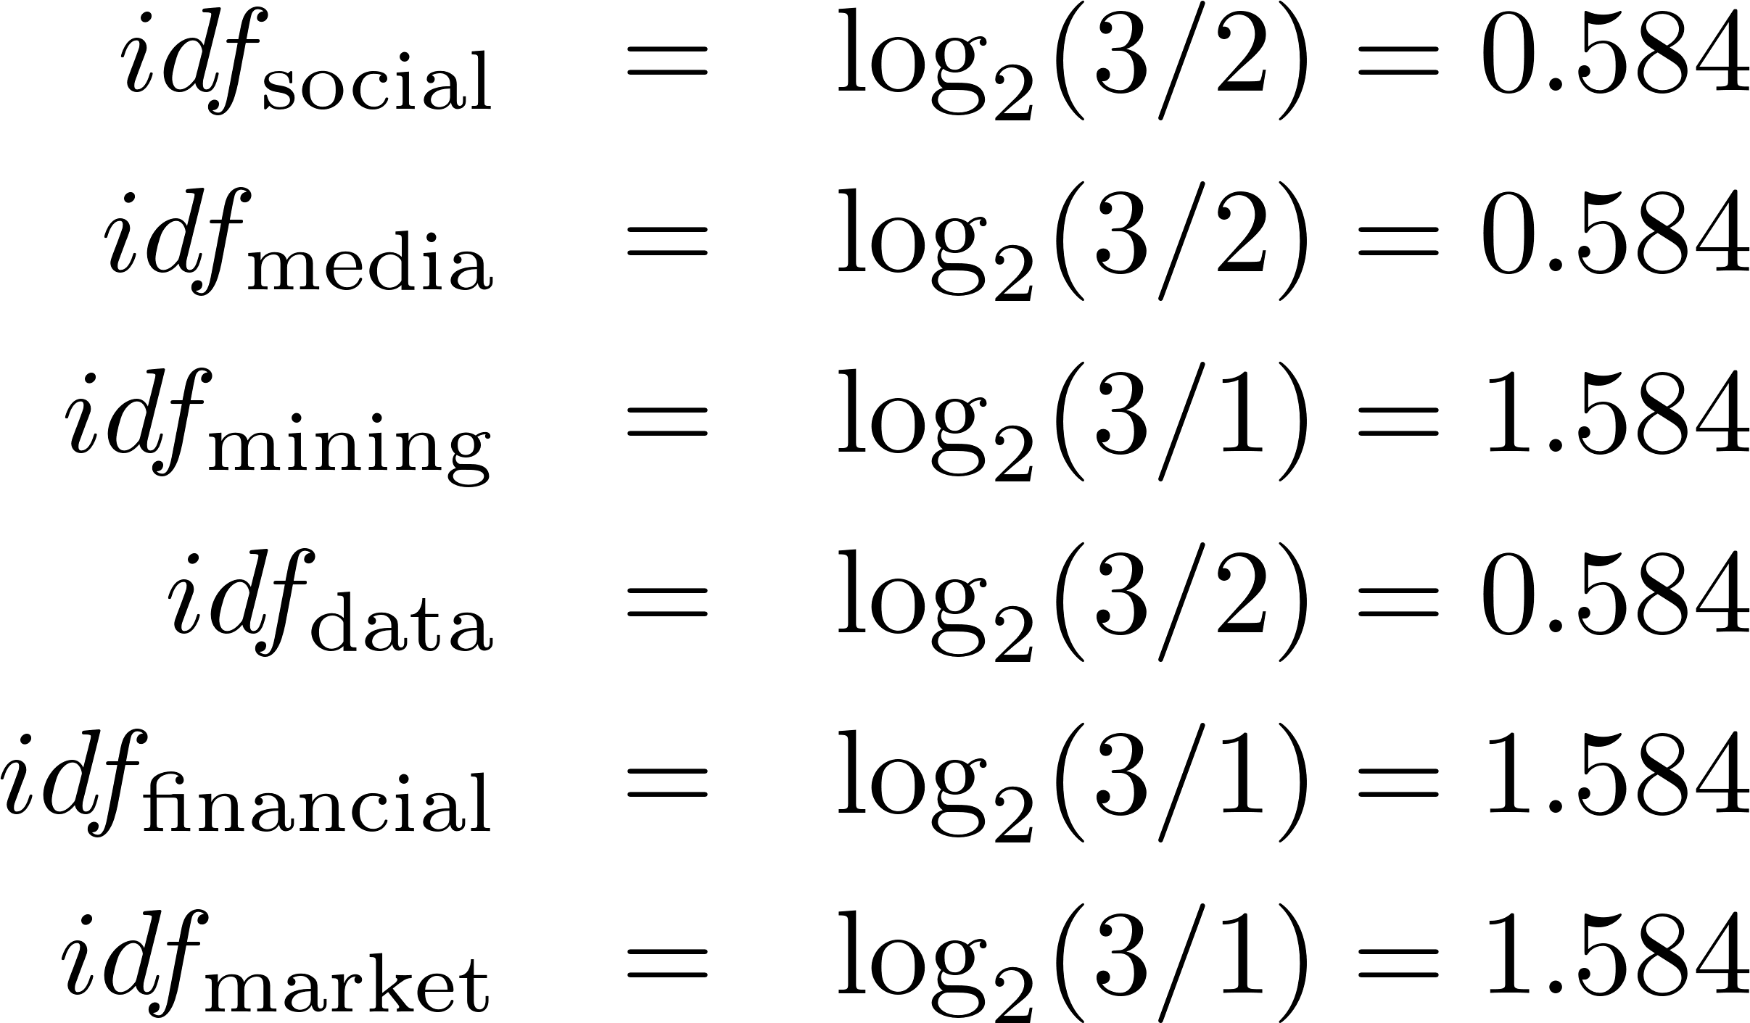
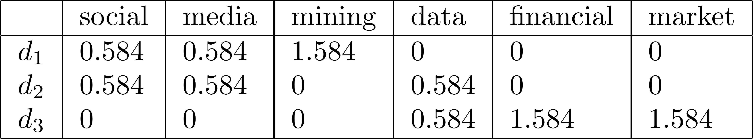
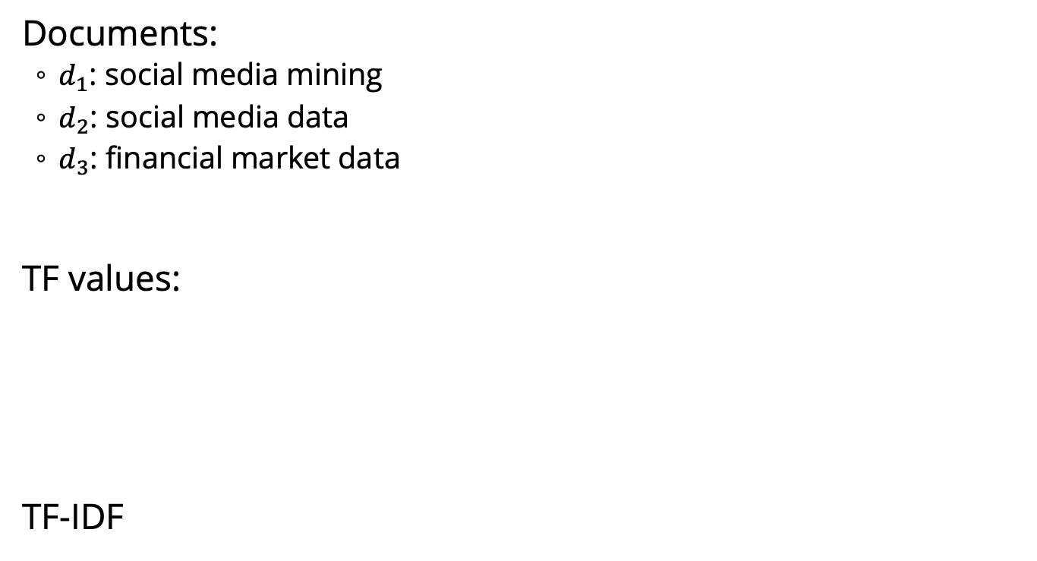
TF-IDF: An Example
Documents:
$d_{1}$: social media mining
$d_{2}$: social media data
$d_{3}$: financial market data
TF values:
TF-IDF

Slide 46
Data Quality
When making data ready for mining, data quality needs to be assured
Noise
Noise is the distortion of the data
Outliers
Outliers are data points that are considerably different from other data points in the dataset
Missing Values
Missing feature values in data instances
Solution:
Remove instances that have missing values
Estimate missing values, and
Ignore missing values when running data mining algorithm
Duplicate data

Slide 47
Data Preprocessing
Aggregation
It is performed when multiple features need to be combined into a single one or when the scale of the features change
Example: image width , image height -> image area (width x height)
Discretization
From continues values to discrete values
Example: money spent -> {low, normal, high}
Feature Selection
Choose relevant features
Feature Extraction
Creating new features from original features
Often, more complicated than aggregation
Sampling
Random Sampling
Sampling with or without replacement
Stratified Sampling: useful when having class imbalance
Social Network Sampling

Slide 48
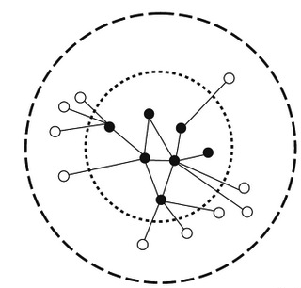
Data Preprocessing
Sampling social networks:
Start with a small set of nodes (seed nodes)
Sample
(a) the connected components they belong to;
(b) the set of nodes (and edges) connected to them directly; or
(c) the set of nodes and edges that are within n-hop distance from them.

Slide 49
Data Mining Algorithms

Slide 50
Data Mining Algorithms
Supervised Learning Algorithm
Classification (class attribute is discrete)
Assign data into predefined classes
Spam Detection
Regression (class attribute takes real values)
Predict a real value for a given data instance
Predict the price for a given house
Unsupervised Learning Algorithm
Group similar items together into some clusters
Detect communities in a given social network

Slide 51
Supervised Learning

Slide 52
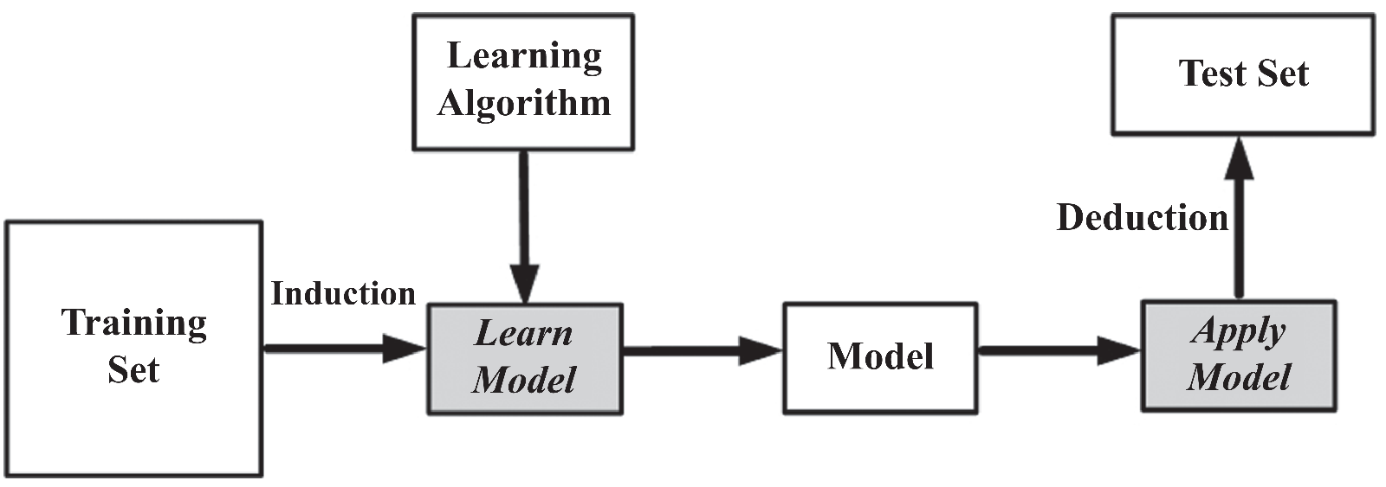
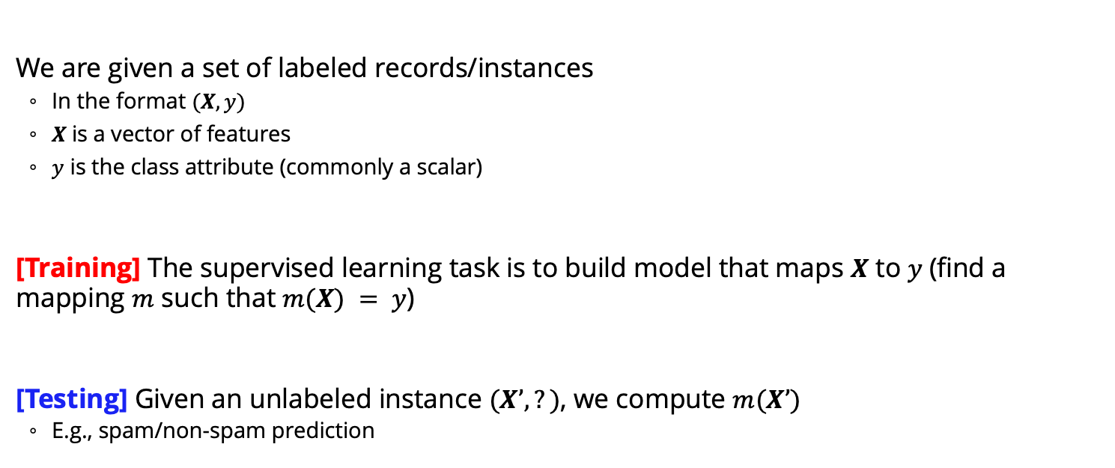
Supervised Learning: The Process
We are given a set of labeled records/instances
In the format $(X, y)$
$X$is a vector of features
$y$ is the class attribute (commonly a scalar)
[Training] The supervised learning task is to build model that maps $X$ to $y$(find a mapping $m$ such that $m(X) = y$)
[Testing] Given an unlabeled instance $(X’,?)$, we compute $m(X’)$
E.g., spam/non-spam prediction

Slide 53
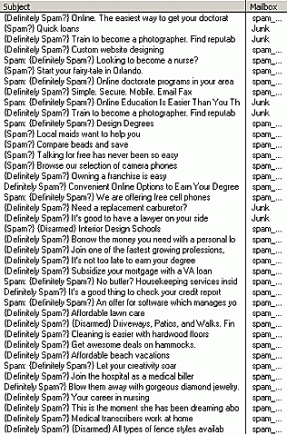
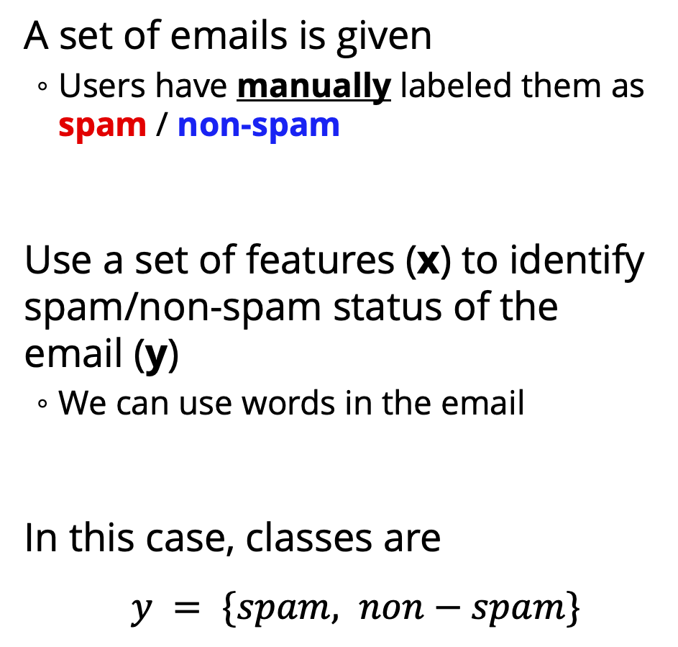
Classification: An Email Example
A set of emails is given
Users have manually labeled them as spam / non-spam
Use a set of features (x) to identify spam/non-spam status of the email (y)
We can use words in the email
In this case, classes are
$y = \{spam, non−spam\}$

Slide 54
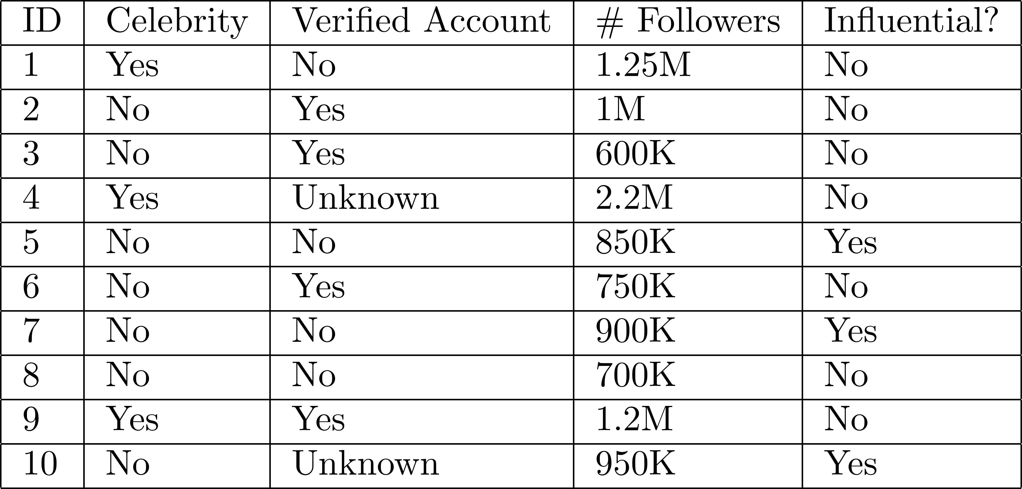
A Twitter Example

Slide 55
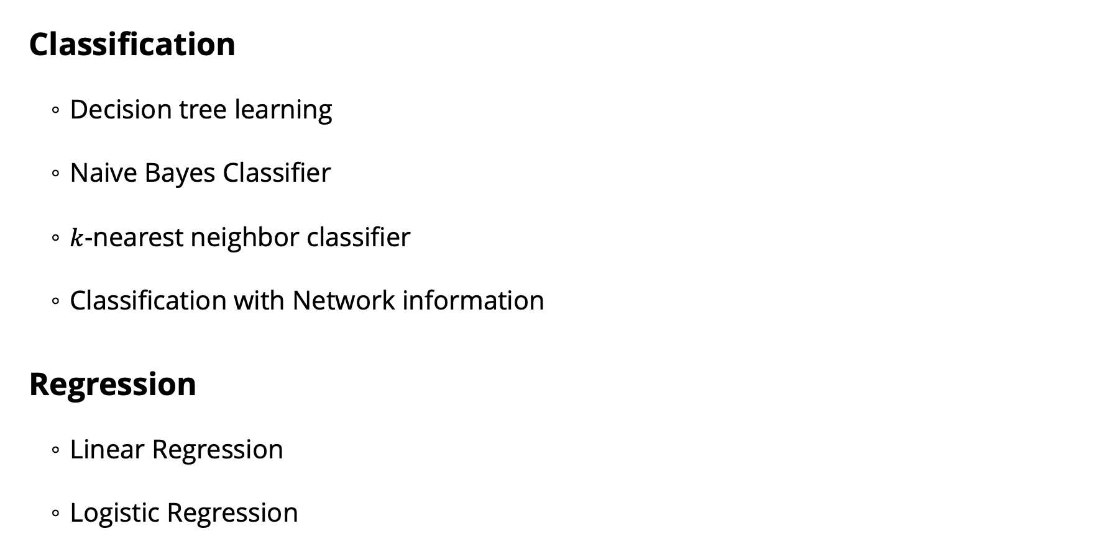
Supervised Learning Algorithms
Classification
Decision tree learning
Naive Bayes Classifier
$k$-nearest neighbor classifier
Classification with Network information
Regression
Linear Regression
Logistic Regression

Slide 56
Decision Tree Learning

Slide 57
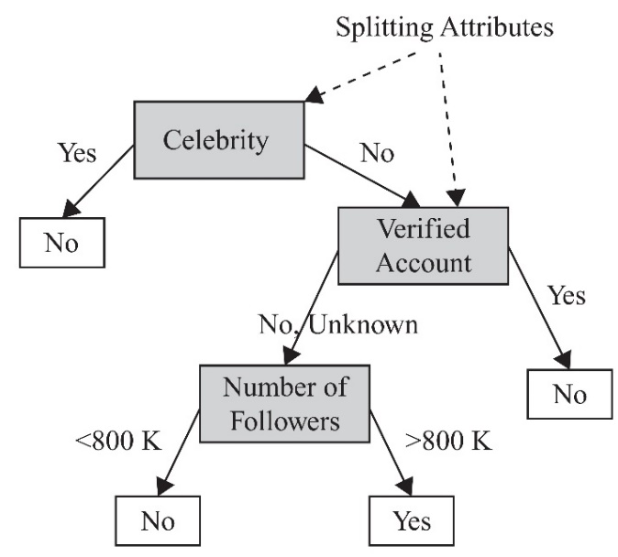
Decision Tree
A decision tree is learned from the dataset
(training data with known classes)
The learned tree is later applied to predict the class attribute value of new data
(test data with unknown classes)
Only the feature values are known

Slide 58
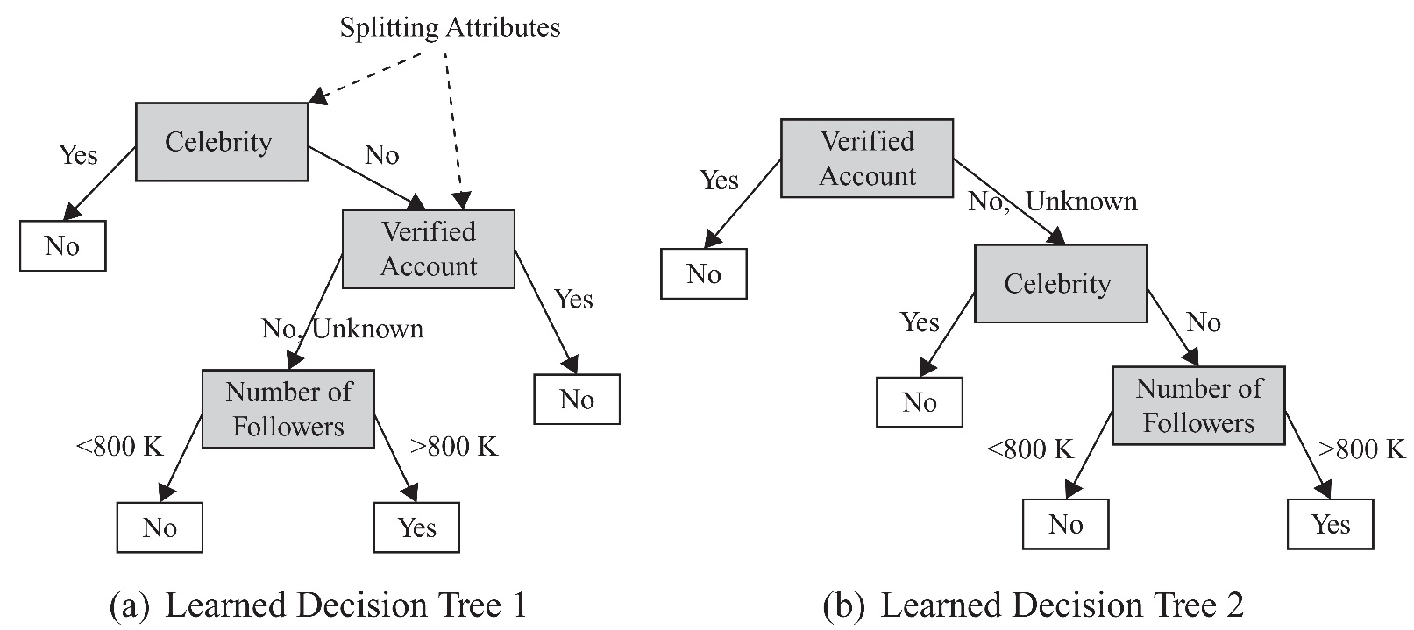
Decision Tree: Example
Multiple decision trees can be learned from the same dataset
Class Labels

Slide 59
Decision Tree Construction
Decision trees are constructed recursively
A top-down greedy approach in which features are sequentially selected.
After selecting a feature for each node,
based on its attribute values, different branches are created.
The training set is then partitioned into subsets based on the feature values,
each of which fall under the respective feature value branch;
The process is continued for these subsets and other nodes
When selecting features, we prefer features that partition the set of instances into subsets that are more pure.
A pure subset has instances that all have the same class attribute value.

Slide 60
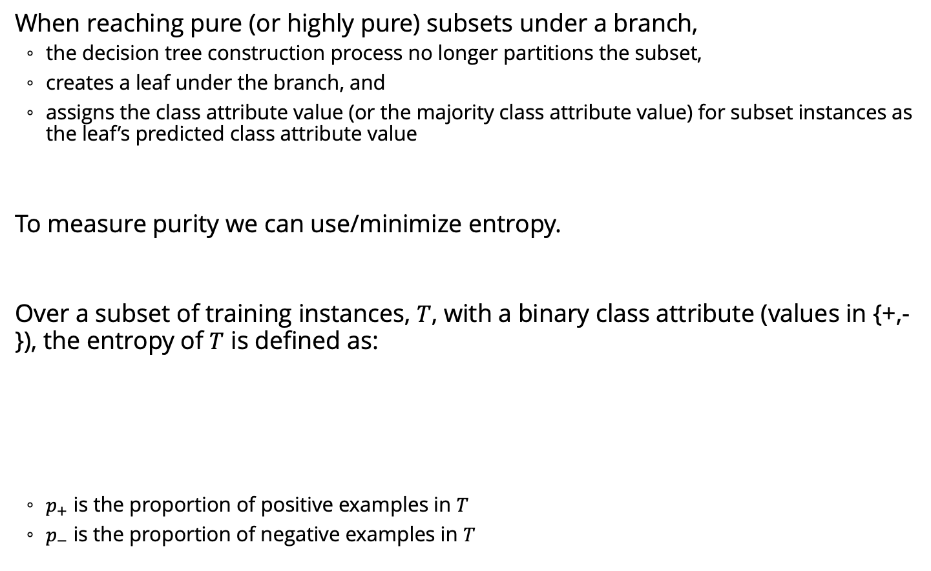
Decision Tree Construction
When reaching pure (or highly pure) subsets under a branch,
the decision tree construction process no longer partitions the subset,
creates a leaf under the branch, and
assigns the class attribute value (or the majority class attribute value) for subset instances as the leaf’s predicted class attribute value
To measure purity we can use/minimize entropy.
Over a subset of training instances, $T$, with a binary class attribute (values in {+,-}), the entropy of $T$ is defined as:
$p_{+}$ is the proportion of positive examples in $T$
$p_{−}$ is the proportion of negative examples in $T$

Slide 61
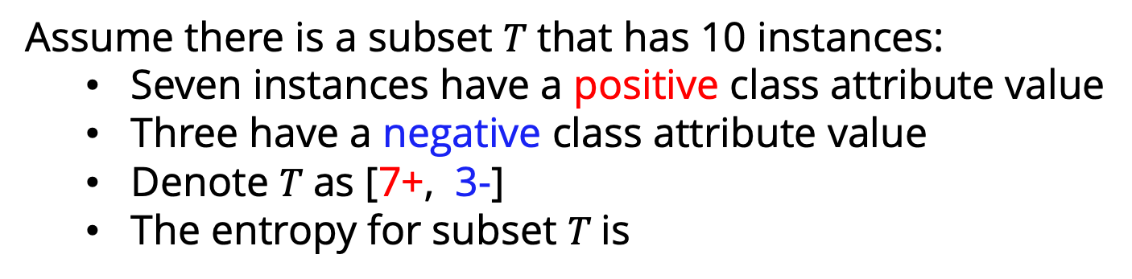
Entropy Example
Assume there is a subset $T$that has 10 instances:
Seven instances have a positive class attribute value
Three have a negative class attribute value
Denote $T$as [7+, 3-]
The entropy for subset $T$is
In a pure subset, all instances have the same class attribute value (entropy is 0)
If the subset contains an unequal number of positive and negative instances
The entropy is between 0 and 1.

Slide 62
Naïve Bayes Learning

Slide 63
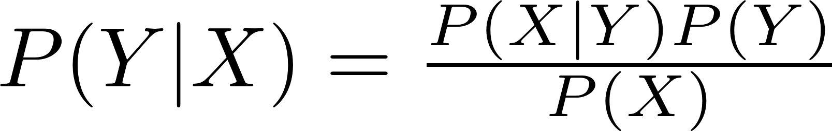
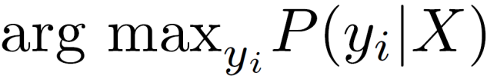
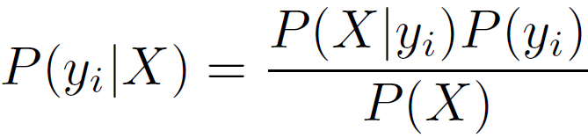
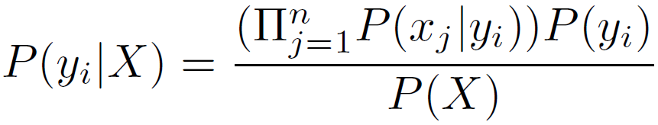
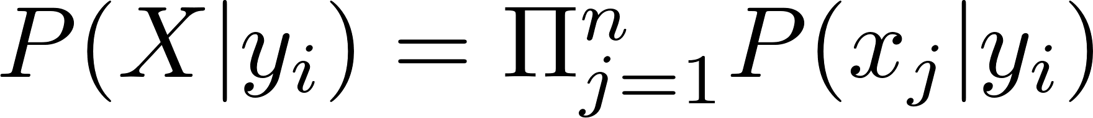
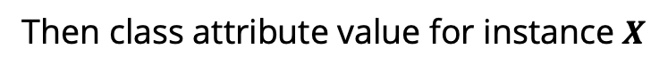
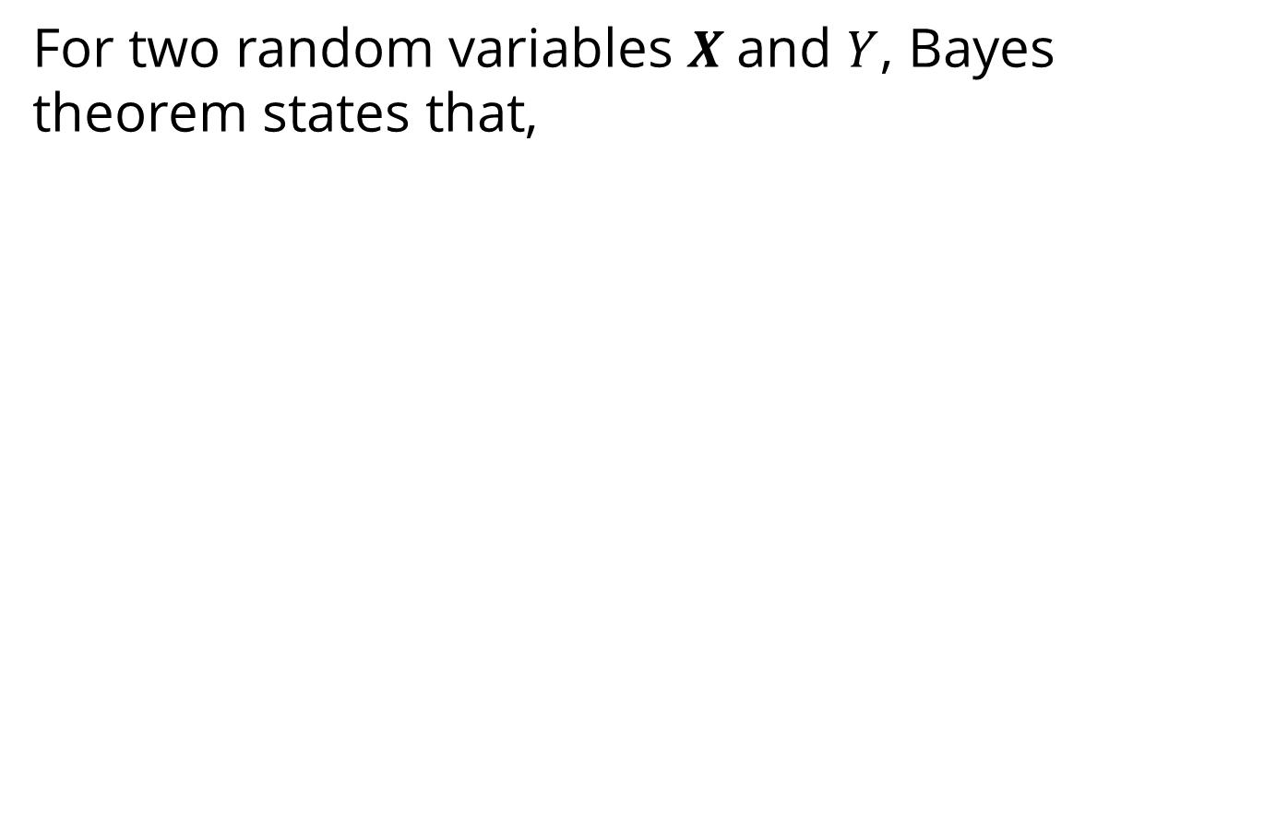
Naive Bayes Classifier
For two random variables $X$and $Y$, Bayes theorem states that,
class variable
the instance features
Then class attribute value for instance $X$
We assume that features are independent given the class attribute

Slide 64
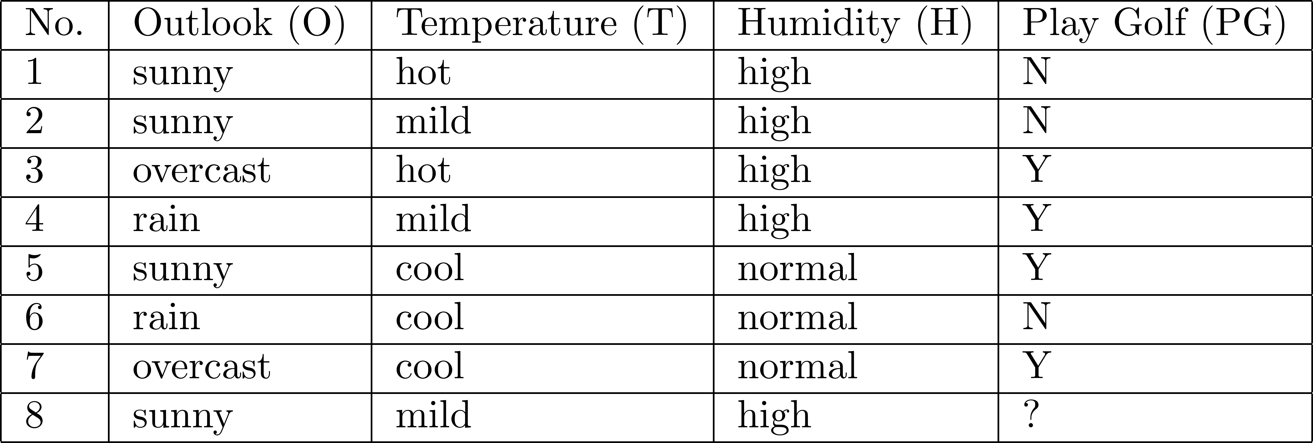
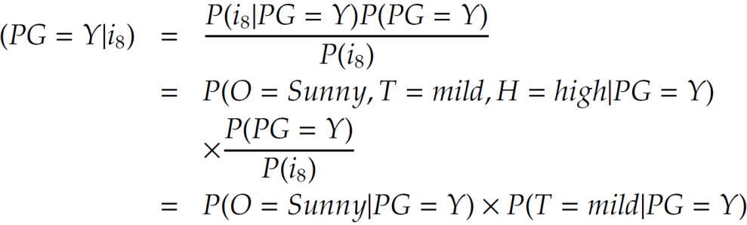
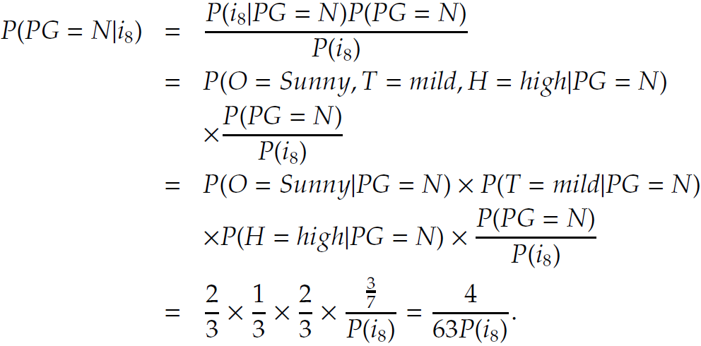
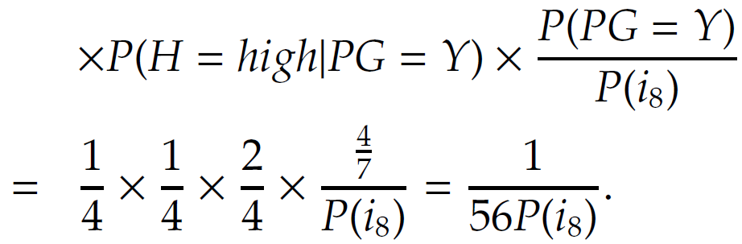
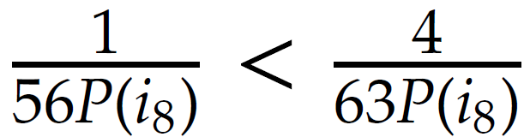
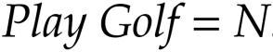
NBC: An Example

Slide 65
Nearest Neighbor Classifier

Slide 66
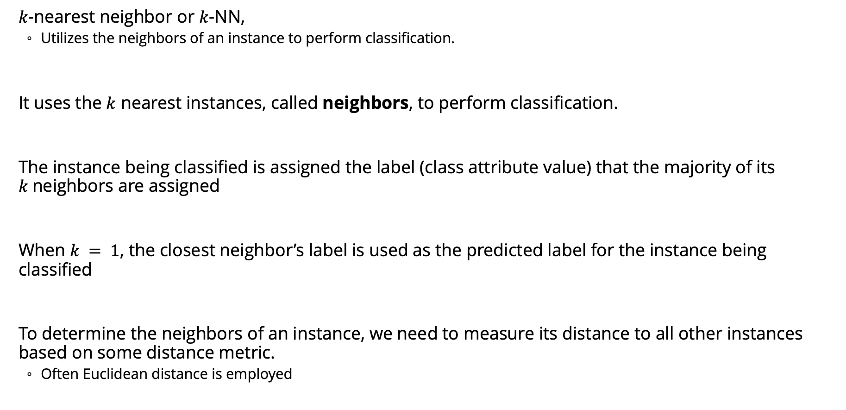
Nearest Neighbor Classifier
$k$-nearest neighbor or $k$-NN,
Utilizes the neighbors of an instance to perform classification.
It uses the $k$ nearest instances, called neighbors, to perform classification.
The instance being classified is assigned the label (class attribute value) that the majority of its $k$neighbors are assigned
When $k = 1$, the closest neighbor’s label is used as the predicted label for the instance being classified
To determine the neighbors of an instance, we need to measure its distance to all other instances based on some distance metric.
Often Euclidean distance is employed

Slide 67
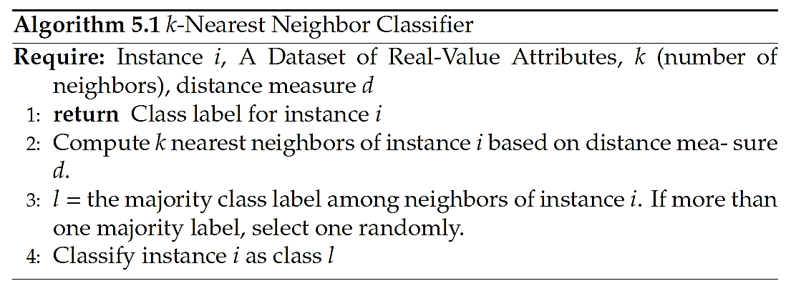
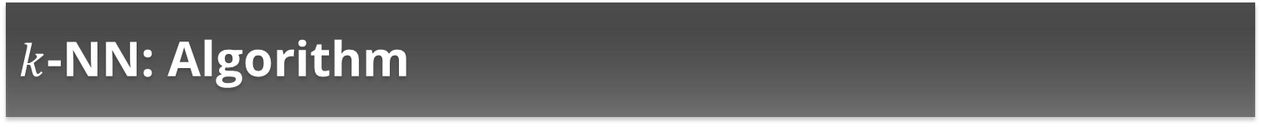
$k$-NN: Algorithm

Slide 68
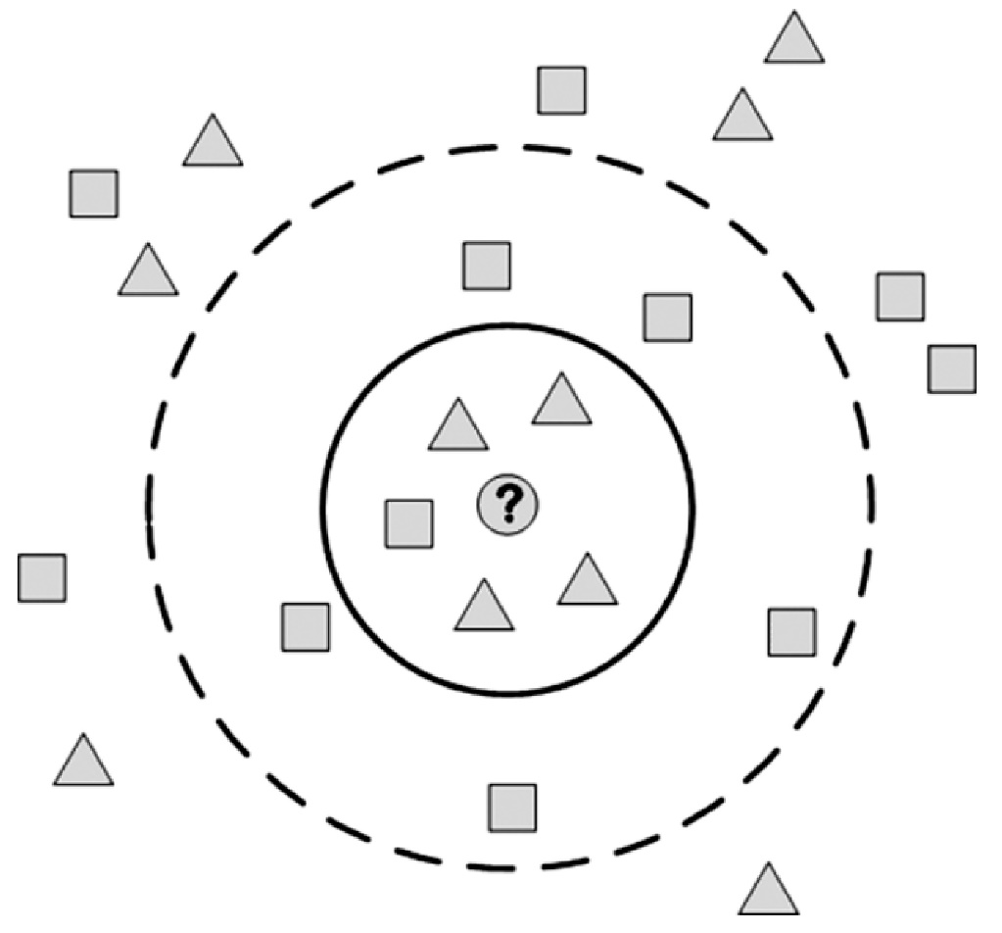
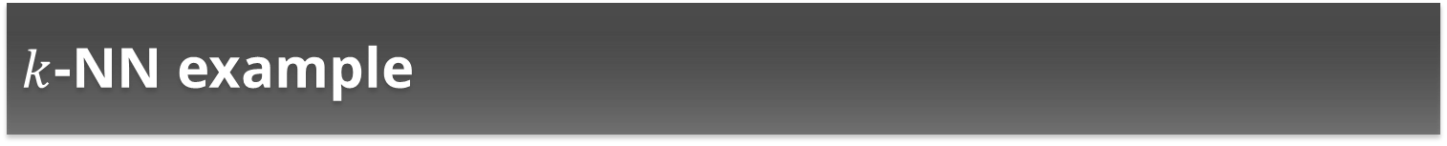

$k$-NN example
When $k=5$, the predicted label is:
When $k=9$, the predicted label is:
∆
□

Slide 69

$k$-NN: Example 2
Similarity between row 8 and other data instances;
(Similarity = 1 if attributes have the same value, otherwise similarity = 0)
Data instance | Outlook | Temperature | Humidity | Similarity | Label | K | Prediction
2 | 1 | 1 | 1 | 3 | N | 1 | N
1 | 1 | 0 | 1 | 2 | N | 2 | N
4 | 0 | 1 | 1 | 2 | Y | 3 | N
3 | 0 | 0 | 1 | 1 | Y | 4 | ?
5 | 1 | 0 | 0 | 1 | Y | 5 | Y
6 | 0 | 0 | 0 | 0 | N | 6 | ?
7 | 0 | 0 | 0 | 0 | Y | 7 | Y
Notes:
Using the inverse of similarity as a distance measure

Slide 70





Recommender Systems - Examples

Slide 71


Main Idea behind Recommender Systems
Use historical data such as the user’s past preferences or similar users’ past preferences to predict future likes
Users’ preferences are likely to remain stable, and change smoothly over time.
By watching the past users’ or groups’ preferences, we try to predict their future interests
Then we can recommend items of interest to them
Formally, a recommender system takes a set of users $U$ and a set of items $I$ and learns a function $f$ such that:

Slide 72
Recommendation vs. Search
One way to get answers is using search engines
Search engines find results that match the query provided by the user
The results are generally provided as a list ordered with respect to the relevance of the item to the given query
Consider the query “best 2014 movie to watch”
The same results for an 8 year old and an adult
Search engines’ results are not customized

Slide 73
Challenges of Recommender Systems
The Cold Start Problem
Recommender systems use historical data or information provided by the user to recommend items, products, etc.
When user join sites, they still haven’t bought any product, or they have no history.
It is hard to infer what they are going to like when they start on a site.
Data Sparsity
When historical or prior information is insufficient.
Unlike the cold start problem, this is in the system as a whole and is not specific to an individual.

Slide 74
Challenges of Recommender Systems
Attacks
Push Attack: pushing ratings up by making fake users
Nuke attack: DDoS attacks, stop the whole recommendation systems
Privacy
Using one’s private info to recommend to others.
Explanation
Recommender systems often recommend items with no explanation on why these items are recommended

Slide 75
AI Builder
BUILD social media POWERED business Apps

Slide 76
AI Builder
AI Builder is a Microsoft Power Platform capability that provides AI models that are designed to optimize your business processes.
AI Builder enables your business to use intelligence to automate processes and glean insights from your data in Power Apps and Power Automate.
With AI Builder, we don't need coding or data science skills to access the power of AI.
We can build custom models tailored to your needs, or choose a prebuilt model that is ready to use for many common business scenarios.

Slide 77
AI Models
Custom AI Model
Pre-built AI Model
Custom Prediction Model

Slide 78
Common Business Scenarios
Scenario | Model Tyoe
Automate customer application processing | Form processing
Automate expense reports | Receipt processing
Categorize user feedback based on their focus | Category classification
Extract insights from product reviews | Entity extraction
Identify language of text | Language detection
Identify and classify customer feedback | Sentiment analysis
Translate support requests into your language | Text translation
Identify fraudulent transactions | Prediction
Get alerted to social media posts referencing your brand | Key phrase extraction
Automate contact list | Business card reader
Automate inventory taking | Object detection
Take a photo of text and save it to a database | Text recognition

Slide 79
Demo
Send a mail notification when a positive tweet is posted

Slide 80
Abstract
People are experiencing a prolonged state of physical isolation from their friends, as well as teachers, extended family, and community networks due to COVID-19 lockdown. While quarantining adults has generally led to negative psychological effects, including confusion, anger, and post-traumatic distress, it is unknown how these measures have impacted children. The twitter consumer sentiment is the most common text classification tool that analyzes an incoming tweet and conveys if the underlying sentiment is positive negative or neutral from the public. A different methodology such as topic modeling is applied to identify the trending topics. By identifying the emotion based on series of time and geographical location can help us understand the effect of lockdown and thus provide remedies to improve the lifestyle.

Slide 81
Introduction
Millions of people are connected with each other on social networking sites and express their sentiments and opinion through tweets, and comments [1].
Sentiment analysis also referred as Opinion mining can be applied at different levels i.e. Document level, Sentence Level, and Feature level [2] [4].
The overall sentiments expressed in the whole document are classified into positive or negative class about a particular object[3].
LDA has become one of the most popular probabilistic text modelling techniques in machine learning [5]. The topic modelling helps us to identify the trending topics during each phase of lockdown.

Slide 82
Introduction
In India, the first case of Coronavirus was recorded on January 31, 2020. As on July 31, 2020, 16,97,054 confirmed cases were recorded. The Indian government imposed various lockdown with restrictions to control the spread of novel Coronavirus. Each lockdown had various restrictions followed by the unlock phases where the restrictions were slowly lifted. Table 1.1 shows the timeline of lockdown.

Slide 83
Introduction
Table 1.1 Lockdown and unlock phases in India
Phase | Start Date | End Date
Pre Lockdown | 31-01-2020 | 24-03-2020
Lockdown 1.0 | 25-03-2020 | 14-04-2020
Lockdown 2.0 | 15-04-2020 | 03-05-2020
Lockdown 3.0 | 04-05-2020 | 17-05-2020
Lockdown 4.0 | 18-05-2020 | 31-05-2020
Unlock 1.0 | 01-06-2020 | 30-06-2020
Unlock 2.0 | 01-07-2020 | 31-07-2020

Slide 84
Data Collection
Keywords
The top 15 keywords selected are 'corona','virus','coronavirus', 'covid19', 'social', 'job' , 'loss' , 'jobloss', 'migrant' , 'treatment' , 'hospital', 'health', 'mask', 'lockdown', 'curfew'.
Location
The tweets were collected with geotagged locations of six major cities in India, i.e, Delhi, Mumbai, Kolkata, Chennai, Bengaluru, Hyderabad. The first three cities represent North India and latter three cities represent South India. The radius of area for each city was set to 100km.
Date Range
The tweets were collected from February 1 to July 31, 2020.

Slide 85
Data Cleaning and Preprocessing
· Lower casing · Removal of Punctuations · Removal of Stopwords · Removal of Frequent words · Removal of Rare words · Stemming · Lemmatization · | Conversion of emoticons to words · Conversion of emojis to words · Removal of URLs · Removal of HTML tags · Chat words conversion · Spelling correction · Removal of ‘#’ from hashtags · Addition of hashtags to tweet

Slide 86
Data Modelling
1. Most common words and hashtags
2. Topic Modelling
3. Polarity of tweets
4. Emotion sentiment of tweets

Slide 87
Most Common Words and Hashtags
The most common words and hashtags that were used during each phase of lockdown and unlock is analyzed from the collected tweets.
The frequency of occurrence of the words and hashtags is stored using a map of word and counts. Using Counter library the same is collected.

Slide 88



Most Common Words

Slide 89
Frequent Hashtags
Phase | Hashtag 1 | Hashtag 2 | Hashtag 3 | Hashtag 4 | Hashtag 5
Pre Lockdown | coronavirus | covid19 | corona | covid | coronavirusoutbreak
Lockdown | covid19 | coronavirus | lockdown | indiafightscorona | stayhome
Unlock | covid19 | jobloss | stayhome | corona | lockdown

Slide 90
Topic Modelling using LDA
LDA assumes the following generative process for each document w in a corpus D:
1. Choose N ∼ Poisson(ξ).
2. Choose θ ∼ Dir(α).
3. For each of the N words wn:
(a) Choose a topic zn ∼ Multinomial(θ).
(b) Choose a word wn from p(wn |zn,β), a multinomial probability conditioned on the topic zn [11].

Slide 91
Topic Modelling using LDA
LDA assumes the following generative process for each document w in a corpus D:
1. Choose N ∼ Poisson(ξ).
2. Choose θ ∼ Dir(α).
3. For each of the N words wn:
(a) Choose a topic zn ∼ Multinomial(θ).
(b) Choose a word wn from p(wn |zn,β), a multinomial probability conditioned on the topic zn [11].

Slide 92
Topic Modelling using LDA
Topic Modelling for Lockdown phase
 | Overall India | South India | North India
Topic #1 | india lockdown coronavirus corona sir health virus treatment migrant small | india covid19 coronavirus police people virus treatment job china covid | coronavirus people lockdown govt mask india job covid corona migrant
Topic #2 | loss india social coronavirus corona covid covid19 people job cases | covid19 lockdown covid people social like need health news corona | covid19 lockdown 19 covid come virus people india face corona
Topic #3 | social health virus lockdown corona media govt covid19 home people | face mask india virus covid lockdown com loss health coronavirus | corona help health virus china covid19 good world job home

Slide 93






Polarity of tweets
Using VADER python library, the tweets can be classified as positive, negative or neutral
.

Slide 94
Emotional Sentiment of Tweet
The polarity of the tweets is not enough to understand the emotion underlying within the tweet text. The emotion can be categorized as fear, anger, anticipation, trust, surprise, positive, negative, sadness, disgust, joy. NRCLex is used to measure emotional affect from a body of text

Slide 95
Emotional Sentiment of Tweet
The polarity of the tweets is not enough to understand the emotion underlying within the tweet text. The emotion can be categorized as fear, anger, anticipation, trust, surprise, positive, negative, sadness, disgust, joy. NRCLex is used to measure emotional affect from a body of text

Slide 96



Emotional Sentiment of Tweet

Slide 97


Emotional Sentiment of Tweet

Slide 98



Emotional Sentiment of Tweet

Slide 99



Let’s connect
Email ID: vivekraja98@gmail.com
Linkedin: @Vivek Raja P S
GitHub: @Vivek0712
Twitter: @vivekraja007

